Slide 1

Mass-suite: A novel Python package designed for mass spectrometry data analysis
Ximin Hu¹, Derek Mar⁴, Nozomi Suzuki⁴, Bowei Zhang⁴, David A. Beck³, Edward P. Kolodziej²
1. Civil and Environmental Engineering, University of Washington, Tacoma, WA, United States. 2. Sciences and Mathematics (UWT); Civil and Environmental Engineering (UWS), University of Washington (Tacoma/Seattle), Tacoma, WA, United States. 3. Chemical Engineering, University of Washington, Seattle, WA, United States. 4. Materials Science and Engineering, University of Washington, Seattle, WA, United States.

Slide 2
Introduction
Why Mass-suite
Full stack capability for Non-target HRMS data processing
Python is popular
Open-source
High Resolution Mass Spectrometry (HRMS)
Novel technology for water quality assessment
Data massive for interpretation and detailed analysis
Current software hard to meet every needs
Pollutant in water
Complicated and coming from different sources
Hard to identification and track
Current technologies are more concentrating on one/few chemical

Slide 3










Overview of Mass-suite
data processing
Other tools
Essential functions for HRMS data processing:
Mzml import
Peak picking
Alignment
Data curation
More..
HRMS data processing assisting tools:
Formula annotation
MS2 spectrum online search
HRMS data quality report
More..
visualization
Always new
Various plot tools for visualizing HRMS data:
Chromatograms
Spectrums
Static/Interactive options
More..
Data mining
There are always something new:
Source identification
Source quantitative apportionment
MS2 data mining
Even more..
Explore HRMS data with data science tools:
Principle Component Analysis
T-SNE Dimension reduction
Clustering analysis based on DBSCAN/OPTICS
Various modeling options
More..

Slide 4
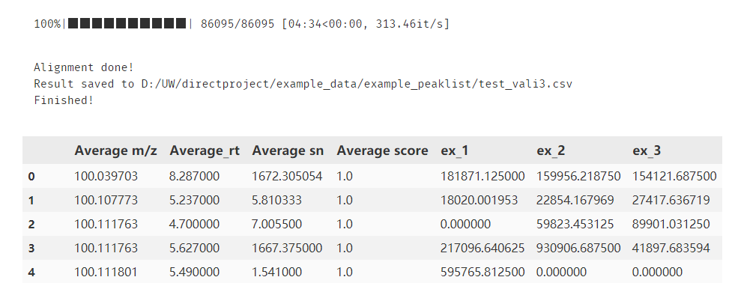
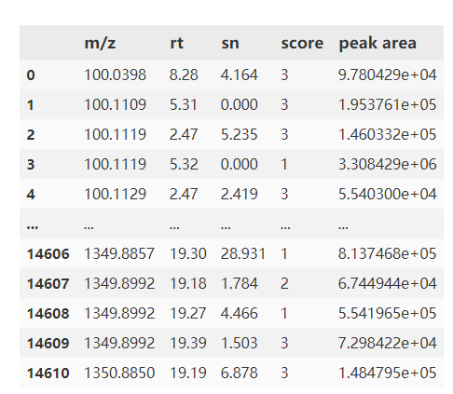
Example showcase
One-line option
mss_process(mzml folder, output filename, *param)
*param defines:
Minimal scan
Intensity filter
Mass error tolerance
Retention time tolerance
Etc.
Step-by-step option
scans = get_scans(filepath, *param) #noise removal noise_removal(scans, threshold) #Generate peak list peak_list(scans, *param)
* Score calculated from randomforest model, built on 5000 training dataset

Slide 5
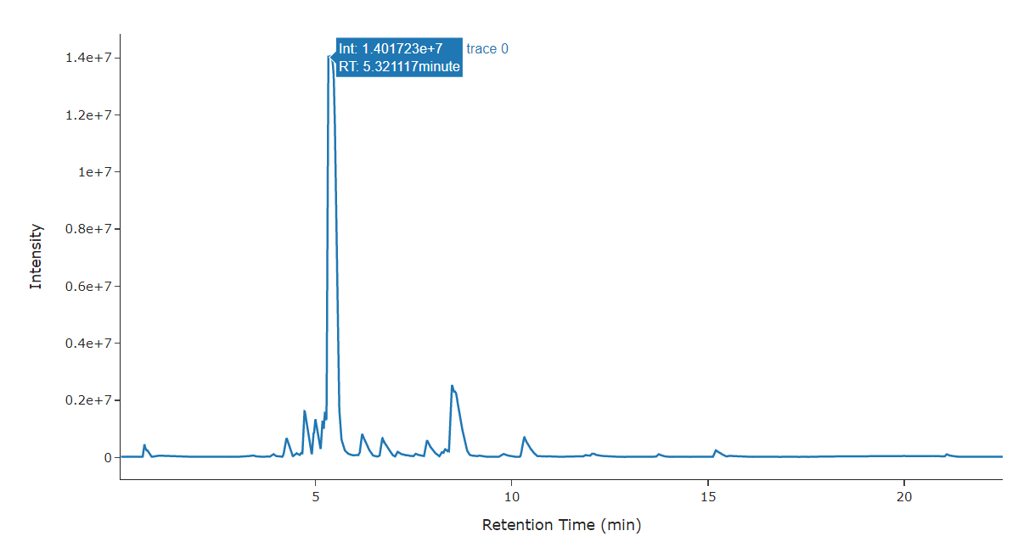
Example showcase
visreader.ms_chromatogram(file, Formula/mass, error, search_by_formula=True)
Other options:
TIC plot
MS spectrum
Isotopic plot
Peak Integration

Slide 6
Formula annotation
Interactive plot for HRMS data visualization
Feature annotation
Realtime database matching and searching using selected database
Example showcase

Slide 7
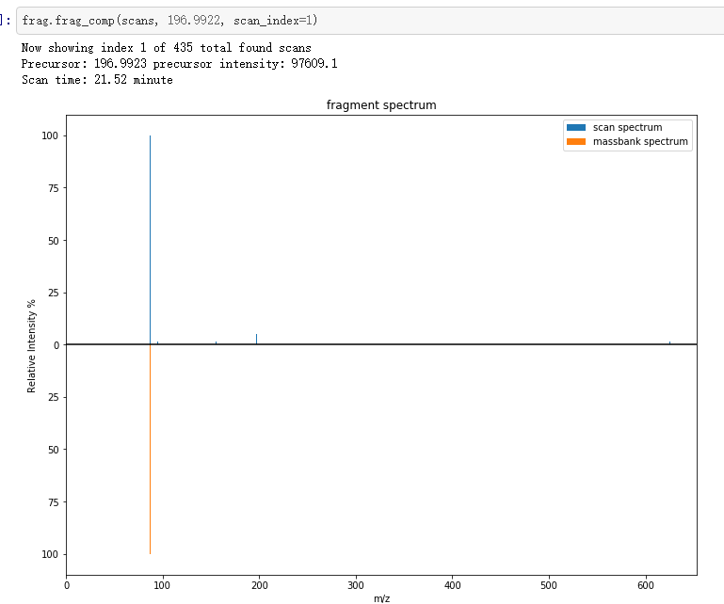
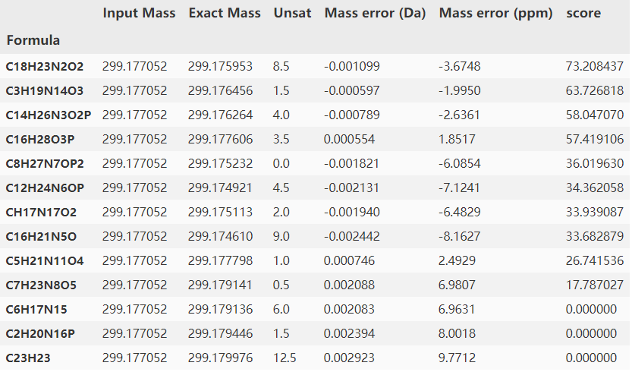
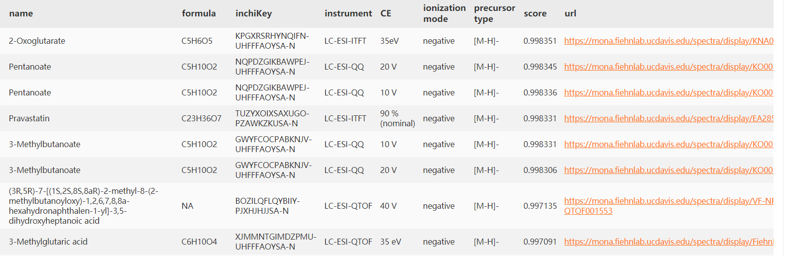

Slide 8
Reliability
Comparison between different software
Reliability test using in-house standards

Slide 9
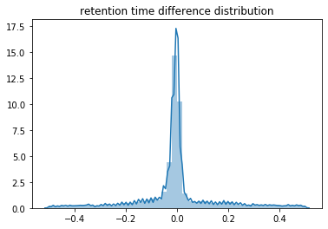
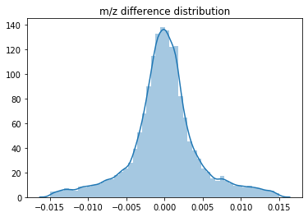
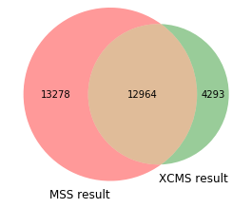
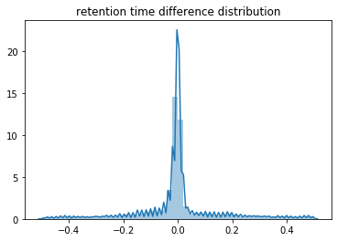
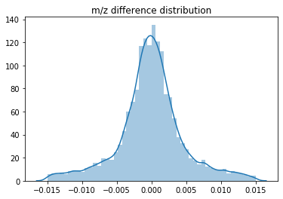
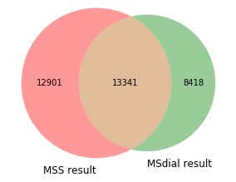
*Test done on the same sample (set of 3) with same parameter, XCMS processed on the web interface

Slide 10

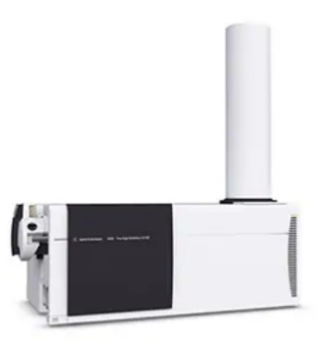
In house sample validation
* Mismatch derives from bad peak shape and function parameter settings
Samples with 413 known compound spiked were processed by Mass-suite

Slide 11
Data mining
Statistical analysis
Clustering analysis
Modeling tools
Mass-suite provides capability for data mining on Non-target HRMS data

Slide 12
Statistical analysis
Basic statistical analysis based on built-in python functions:
PCA/T-SNE
T-test
Volcano plot
Similarity comparison
Etc.

Slide 13
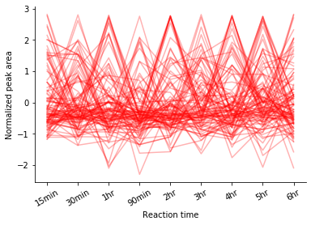
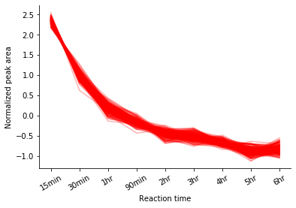
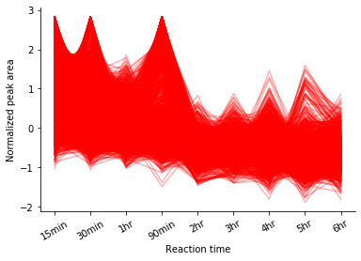
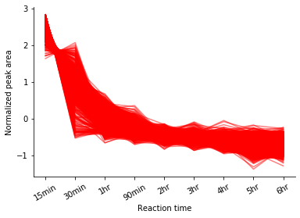
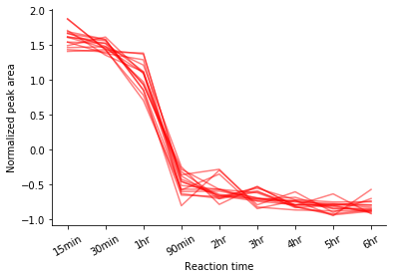
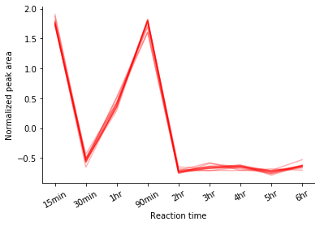
Distinguishing noise
Find similar features with error tolerance
Distinguish between different behaviors

Slide 14
Modeling options for user
General function
Rf/lasso/other
Linear regression
Use cluster
Use cluster
Use all features
Use all features
Ensemble method
Separate model information & report
Separate model information & report
Performance report
Performance report
Performance report
Merged model
Merged model

Slide 15
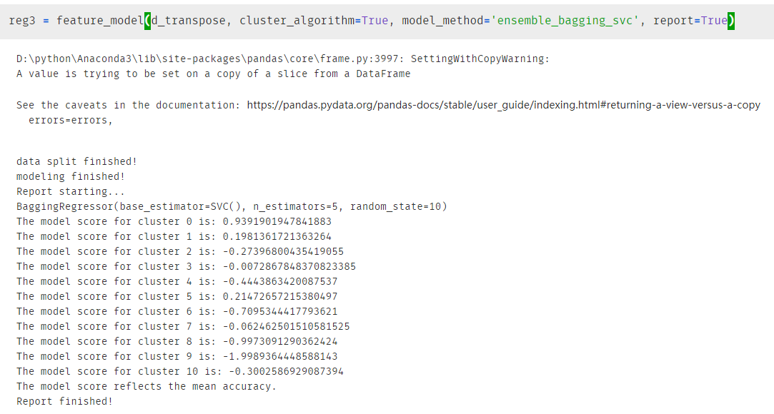
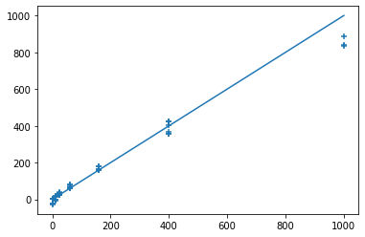
Modeling output
Based on the cluster information and model score, user can pick individual clusters for prediction.

Slide 16
Comparison
Tool Features | Mass-suite | TidyMS | MZmine2 | XCMS | MS-DIAL | Profinder & MPP
Language | Python | Python | Java | R | C#
Rawdata preprocessing | √ | √ | √ | √ | √ | √
Data curation | √ | √ | √ | × | √ | √
QC-based batch correction | × | √ | × | × | × | ×
Quality reports | √ | √ | √ | × | √ | ×
Normalization, imputation, scaling | √ | √ | √ | × | √ | ×
Feature annotation | △ | × | √ | × | √ | √
Isotope grouping | × | × | √ | √ | √ | √
Interactive visualization plots | √ | × | √ | × | √ | √
Clustering statistical analysis | √ | × | × | × | × | ×
△ The annotation tool is still under development
Reference: Riquelme G, Zabalegui N, Marchi P, Jones CM, Monge ME. A Python-Based Pipeline for Preprocessing LC-MS Data for Untargeted Metabolomics Workflows. Metabolites. 2020 Oct 16;10(10):416. doi: 10.3390/metabo10100416. PMID: 33081373; PMCID: PMC7602939.

Slide 17
Benchmarks
70%
Agreement on feature detection
As reliable as other platforms
99%
Accuracy of peak picking
With additional scoring based on RandomForest model
8 min/file*
Average processing time
Capable to be boosted up by supercomputers
4 Tools
Powering Non-target analysis
Based on data science approaches
30 Mb
Package size
Light for the installation and use
Open Source
Of the entire package
Keep updating, anyone can be involved,
the most flexible option
*Tested using default parameters as intensity cut = 2000, mz error = 10 ppm, alignment mz error = 10 ppm, rt error = 0.5 min, model_scoring was off, test were performed on personal laptop (Intel(R) Core(TM) i7-7700HQ CPU, 16GB RAM)
Notes:
Statistical tools, clustering tools, modeling tools and source identification tool (in dev)

Slide 18
Future development & update
Source identification tool
Understand chemical commonality found by tools
GUI/webtool on visualization and for non-programmer users
Dynamically update according to needs

Slide 19
Related information
Installation:
https://pypi.org/project/mass-suite/
Github page & documentation:
https://github.com/XiminHu/mass-suite
Contact:
xhu66@uw.edu
Suggestions or collaborations are always welcome !

Slide 20
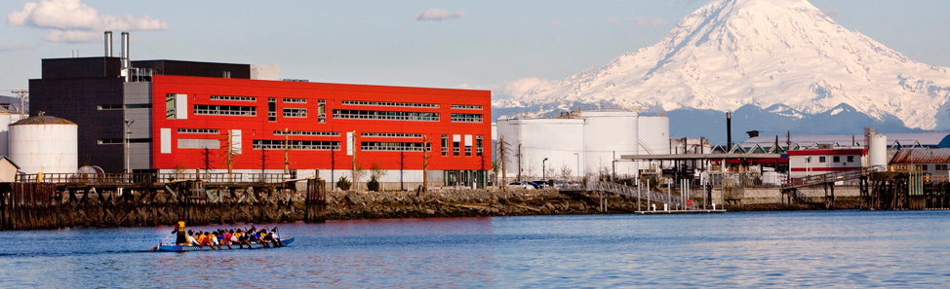

Acknowledgement:
A big shout to Professor Edward Kolodziej, Professor Dave Beck, Dr. Katherine Peter, and the Center of Urban Water for all their help during the development of this package.

Slide 21
References
M Kösters et al; pymzML v2.0: introducing a highly compressed and seekable gzip format, Bioinformatics, doi: https://doi.org/10.1093/bioinformatics/bty046
Pedregosa et al., Scikit-learn: Machine Learning in Python, JMLR 12, pp. 2825-2830, 2011.
Martin Ester et al. 1996. A density-based algorithm for discovering clusters in large spatial databases with noise. In Proceedings of the Second International Conference on Knowledge Discovery and Data Mining (KDD'96). AAAI Press, 226–231.
Riquelme G et al. A Python-Based Pipeline for Preprocessing LC-MS Data for Untargeted Metabolomics Workflows. Metabolites. 2020 Oct 16;10(10):416. doi: 10.3390/metabo10100416. PMID: 33081373; PMCID: PMC7602939.
Tsugawa, Hiroshi et al. “MS-DIAL: data-independent MS/MS deconvolution for comprehensive metabolome analysis.” Nature methods vol. 12,6 (2015): 523-6. doi:10.1038/nmeth.3393
Horai, H. et al (2010), MassBank: a public repository for sharing mass spectral data for life sciences. J. Mass Spectrom., 45: 703-714. https://doi.org/10.1002/jms.1777
Katherine T. Peter et al., Application of Nontarget High Resolution Mass Spectrometry Data to Quantitative Source Apportionment, Environmental Science & Technology 2019 53 (21), 12257-12268 DOI: 10.1021/acs.est.9b04481

Slide 22

Thanks!

